Slide 1

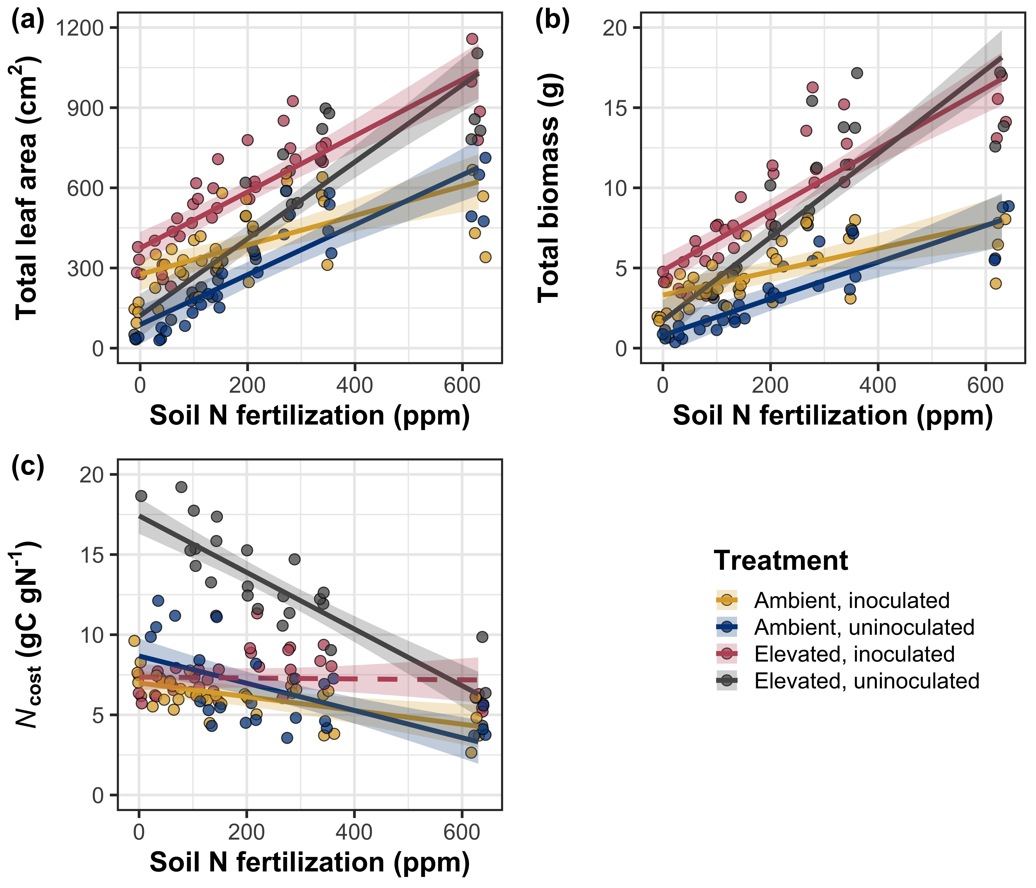


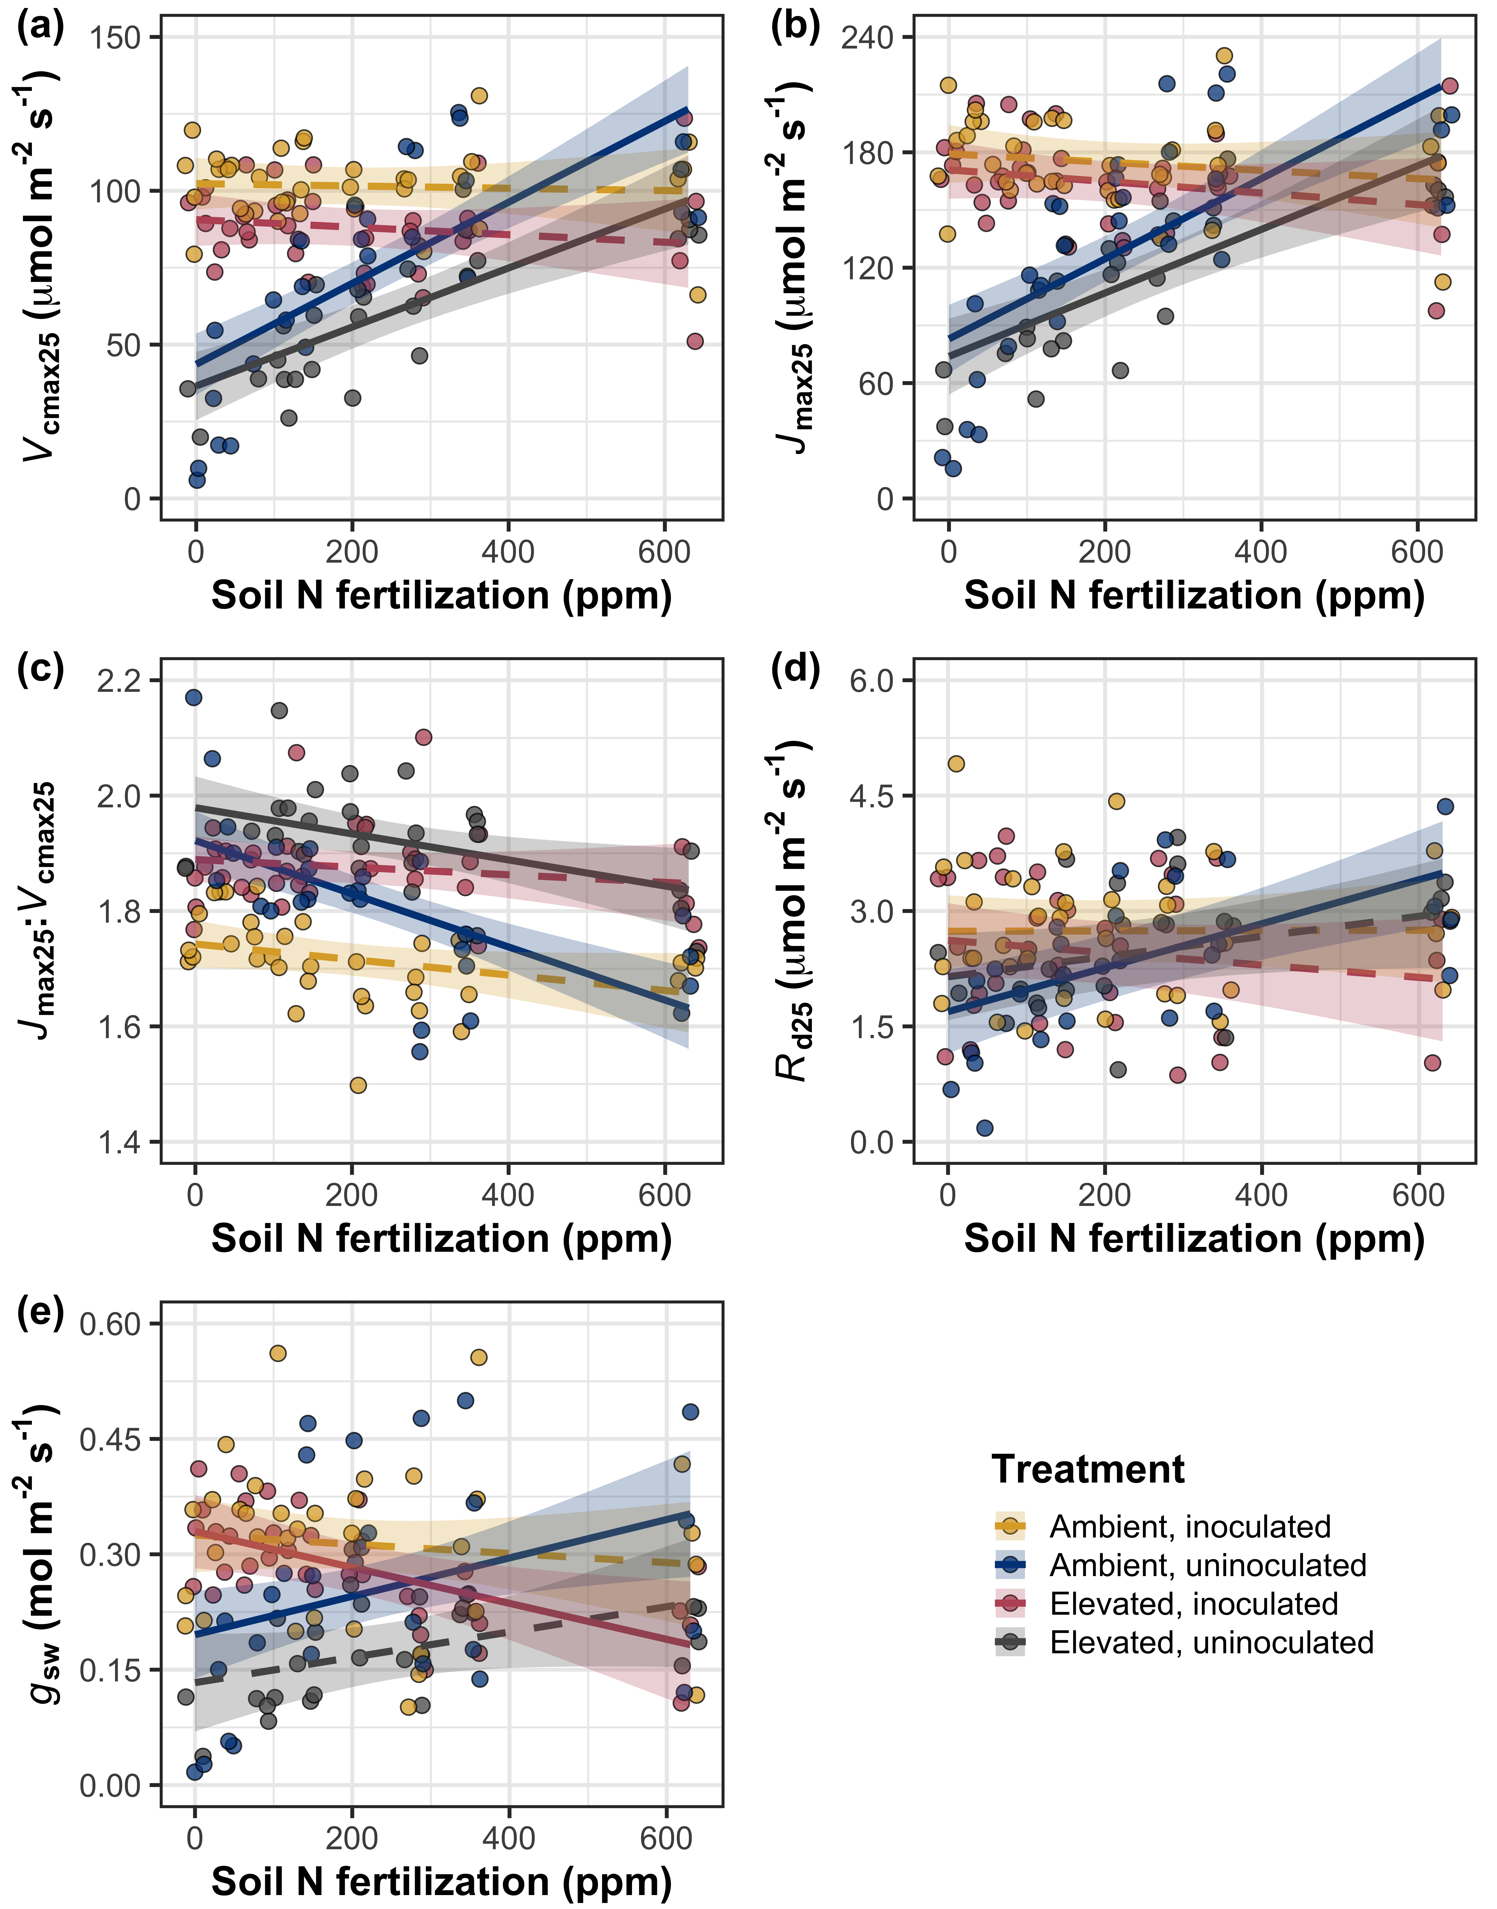
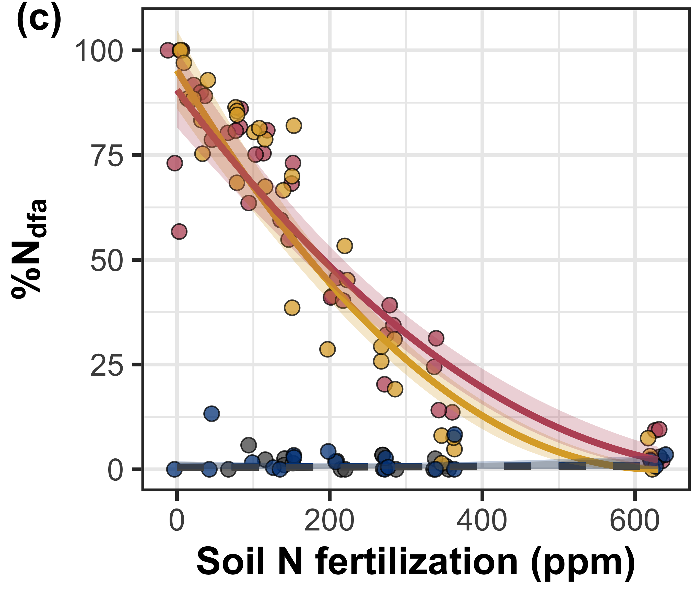
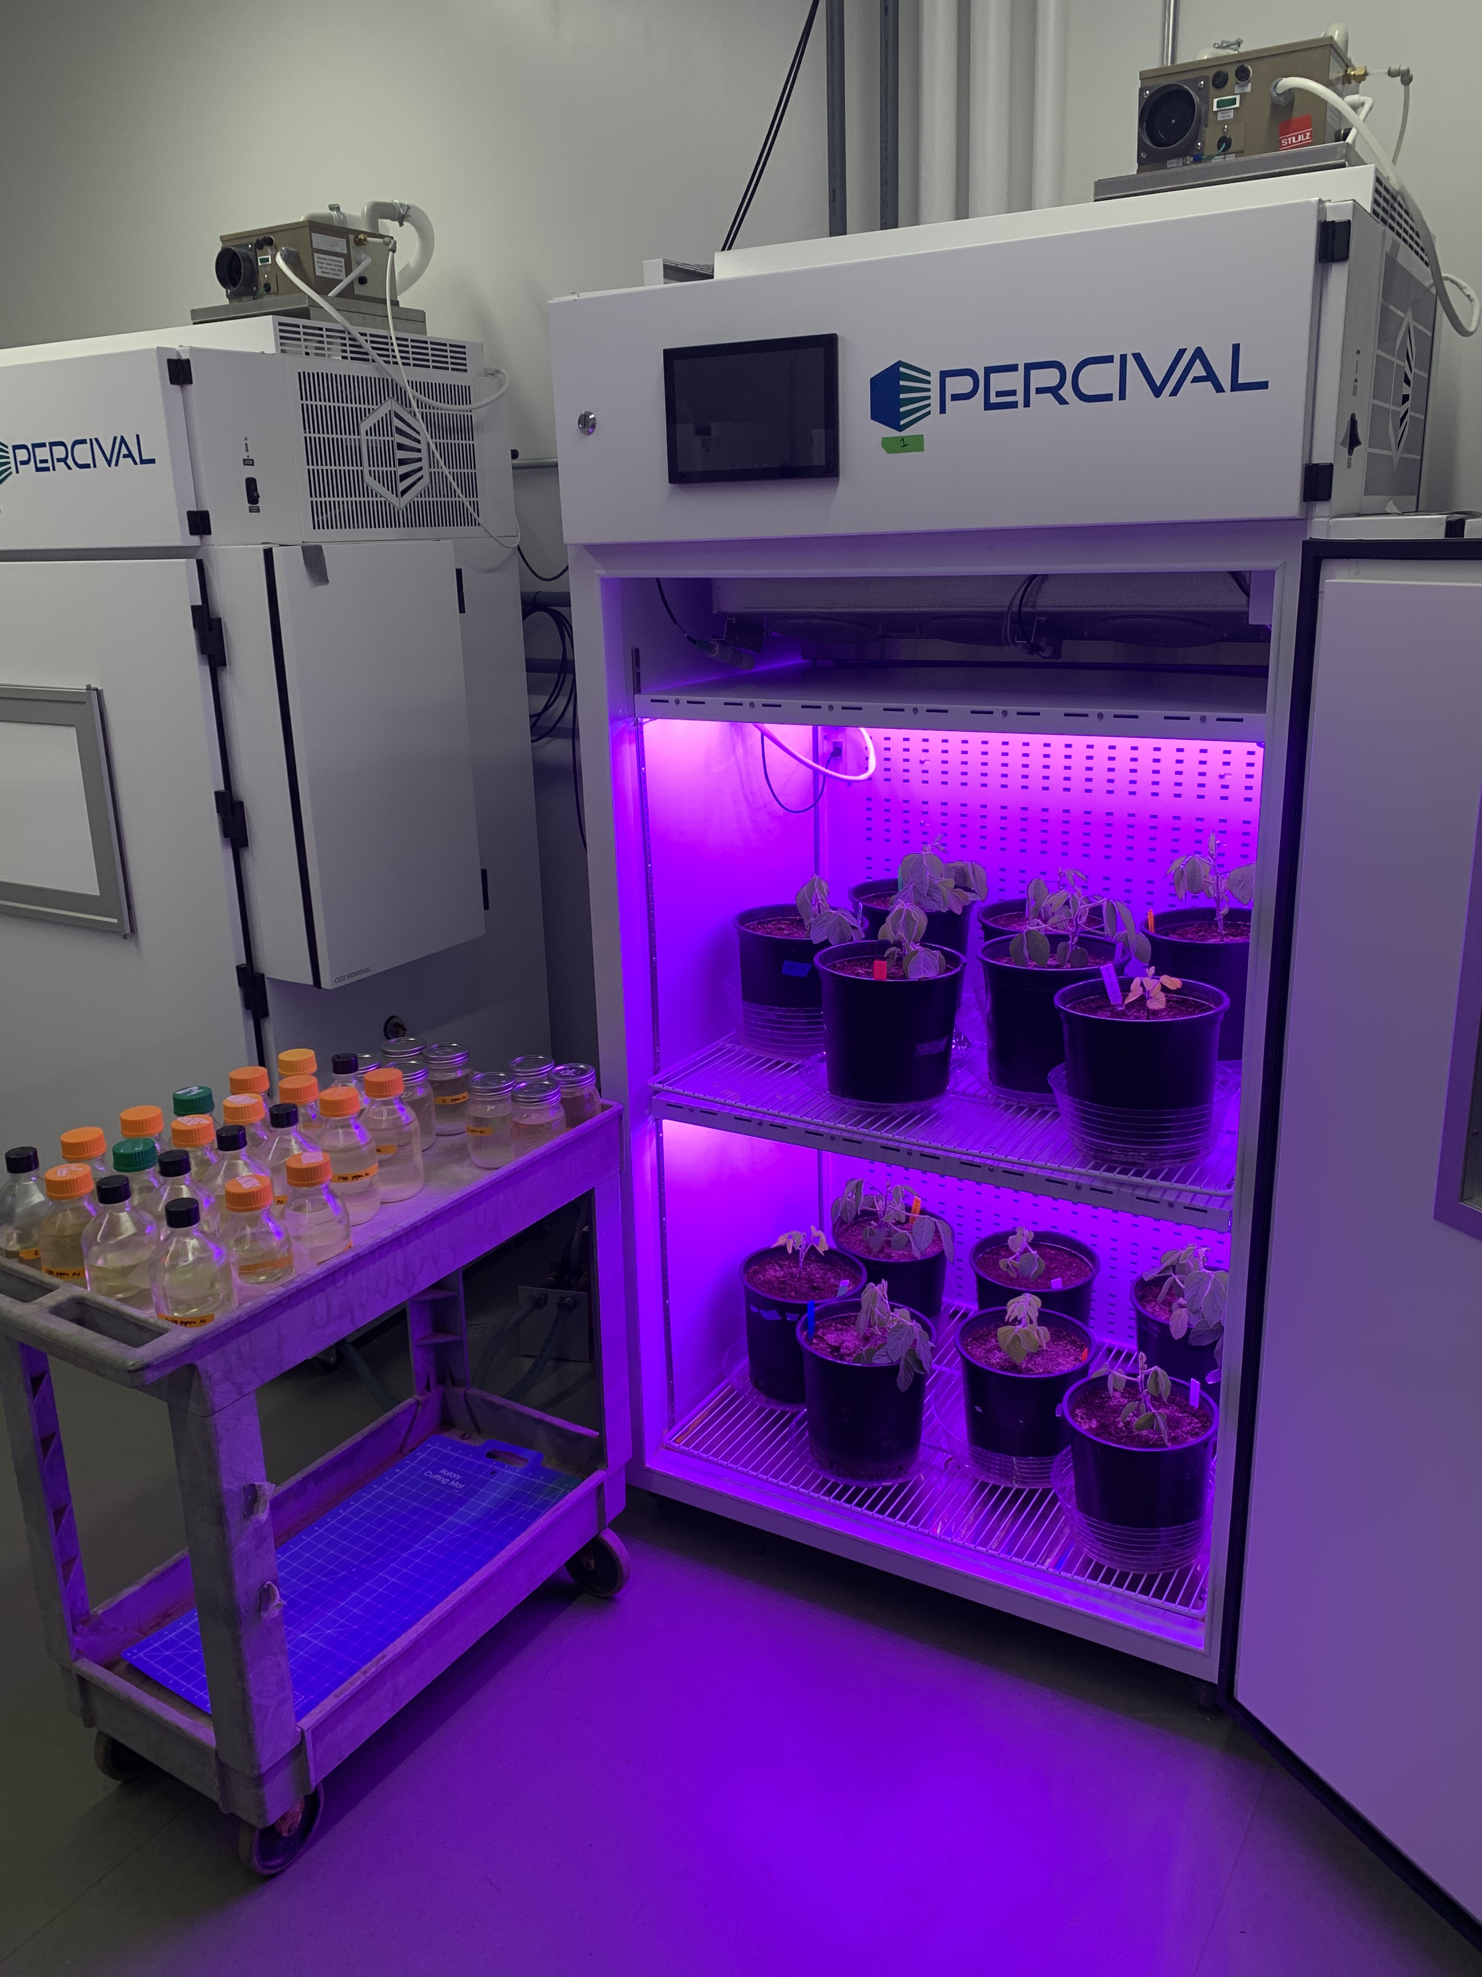
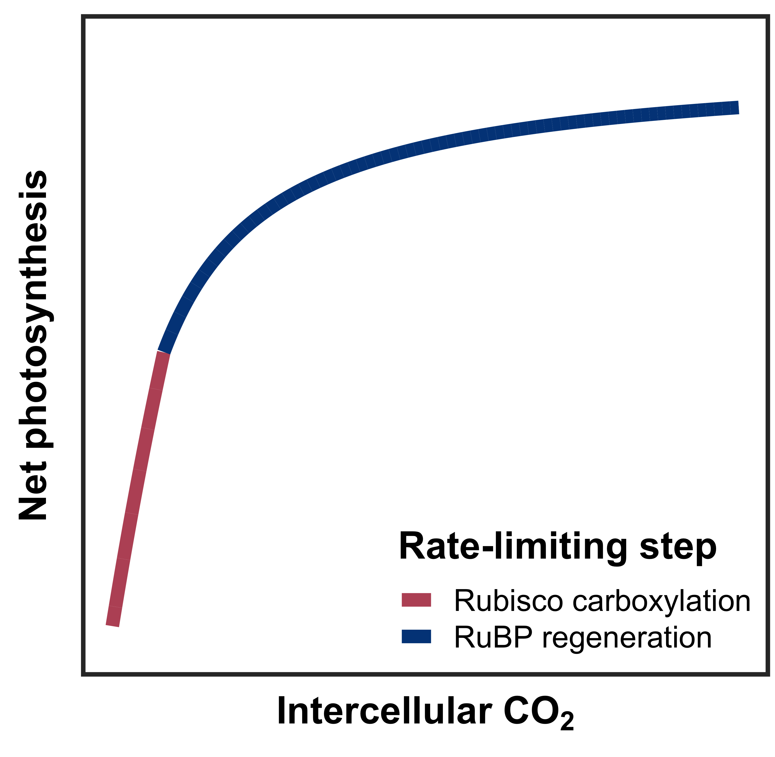
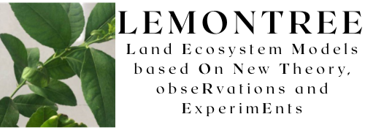


Leaf acclimation to elevated CO₂ is independent of soil nitrogen fertilization and rhizobial inoculation
Elevated CO₂ reduced photosynthetic process rates independent of fertilization…
Elevated CO₂ increased cost of acquiring N, while increasing fertilization decreased
carbon cost of acquiring N
Evan A. Perkowski¹, Ezinwanne Ezekannagha¹, Nicholas G. Smith¹
¹Department of Biological Sciences, Texas Tech University, Lubbock, Texas, USA
evan.a.perkowski@ttu.edu
@EvanPerkowski
INTRODUCTION
Plants reduce stomatal conductance and photosynthetic capacity in response to elevated CO₂ (eCO₂)
Progressive nitrogen (N) limitation – leaf responses to eCO₂ are a function of progressive declines in soil N availability due to positive relationships between soil N, leaf N, and photosynthetic capacity
Optimal coordination theory – leaf responses to eCO₂ are independent of soil N availability, are instead driven by optimal resource investment to photosynthetic capacity
We grew Glycine max L. (Merr) under two CO₂ treatments across nine fertilization levels in a full-factorial growth chamber experiment
Increasing fertilization reduced investment in symbiotic N fixation similarly between CO₂ treatments
METHODS
1
Species
(Glycine max)
… while increasing fertilization increased
the positive effect of elevated CO₂ on whole plant growth
2
CO₂ concentrations
(420 ppm, 1000 ppm)
2
Inoculation treatments (+/- B. japonicum)
9
Fertilization treatments
(0-630 ppm N)
DISCUSSION AND CONCLUSIONS
Leaf responses to CO₂ support patterns expected from optimal coordination theory
Reductions in V_{cmax25} and J_{max25} under eCO₂ were independent of fertilization or inoculation
V_{cmax25} experienced stronger reductions under eCO₂ than J_{max25}, allowing net photosynthesis to approach optimal coordination of Rubisco carboxylation and RuBP regeneration
Whole plant responses to CO₂ support patterns expected from progressive N limitation
Increased growth under eCO₂ was enhanced under increasing fertilization and in inoculated pots under low fertilization
Elevated CO₂ increased whole plant N uptake
MEASUREMENTS AND CALCULATIONS
CO₂ response curves
Maximum Rubisco carboxylation rate (V_{cmax25})
Maximum RuBP regeneration rate (J_{max25})
Total leaf area, total biomass
Structural C cost to acquire N
% N fixed from the atmosphere

